Slide 1
CUI TRAINING
TEMPLATE
VERSION 2.0
These training slides are a resource that DOD and Industry can use to provide to personnel required to complete CUI training. The training fulfills CUI training requirements.

Slide 2

IMPORTANT
UNCLASSIFIED
The FIRST thing you should do BEFORE working with Controlled Unclassified Information (CUI) is to WORK WITH THE INFORMATION OWNER (customer, prime, agency, GCA, etc.) to validate CUI requirements.
Always obtain clear, written verification and guidance on how to receive, handle, and store material under your contract/customer (i.e., CUI marking guide).
Work with the Defense Counterintelligence Security Agency (DCSA) to assist with guidance if you are unable to obtain it from the Information Owner.
BE CAREFUL! Once you start marking things CUI,
you now have network and other requirements
you must adhere to.
UNCLASSIFIED

Slide 3
CONTENTS
Introduction
Why?
Previous Markings
How and Who Decides?
CUI Life Cycle
  Create/Receive
  Identify/Designate
  Mark/Label
  Storage/Safeguard
  Disseminate
  Decontrol/Destroy
Unauthorized Disclosure/Disciplinary Actions
Wrap Up
References
Certificate of Completion
NOTE: The contents of this briefing—including illustrations—are Unclassified

Slide 4

INTRODUCTION
Federal agencies routinely generate, use, store, and share information that requires some level of protection from unauthorized access and release.
Protection may be required for privacy, law enforcement, or other reasons pursuant to and consistent with law, regulation, and/or Government-wide policy.
Historically, each agency developed its own practices for sensitive unclassified information, resulting in a patchwork of systems.
CUI represents an unprecedented initiative to standardized safeguarding practices.

Slide 5


WHY CUI TRAINING?
CUI training will be conducted ANNUALLY and, at a minimum, must include the following items (per CUI Notice 2016-01 and DoDI 5200.48):
Convey individual responsibilities related to protecting CUI;
Identify the categories or subcategories routinely handled by agency personnel and any special handling requirements
(i.e., for CUI Specified);
Describe the CUI Registry, its purpose, structure, and location (i.e., http://www.archives.gov/cui/);
Describe the differences between CUI Basic and CUI Specified;
Identify the offices or organizations with oversight responsibility for the CUI Program;
Address CUI marking requirements, as described by agency policy;
Address the required physical safeguards and methods for protecting CUI, as described by agency policy;
Address the destruction requirements and methods, as described by agency policy;
Address the incident reporting procedures, as described by agency policy;
Address the methods and practices for properly sharing or disseminating CUI within the agency and with external entities inside and outside the Executive branch; and
Address the methods and practices for properly decontrolling CUI, as described by agency policy.
NOTE: Industry organizations may develop their own CUI training.
This presentation captures all 11 categories, but Industry may instead use this training to meet the requirement:
DoD CDSE CUI course https://securityhub.usalearning.gov/.

Slide 6
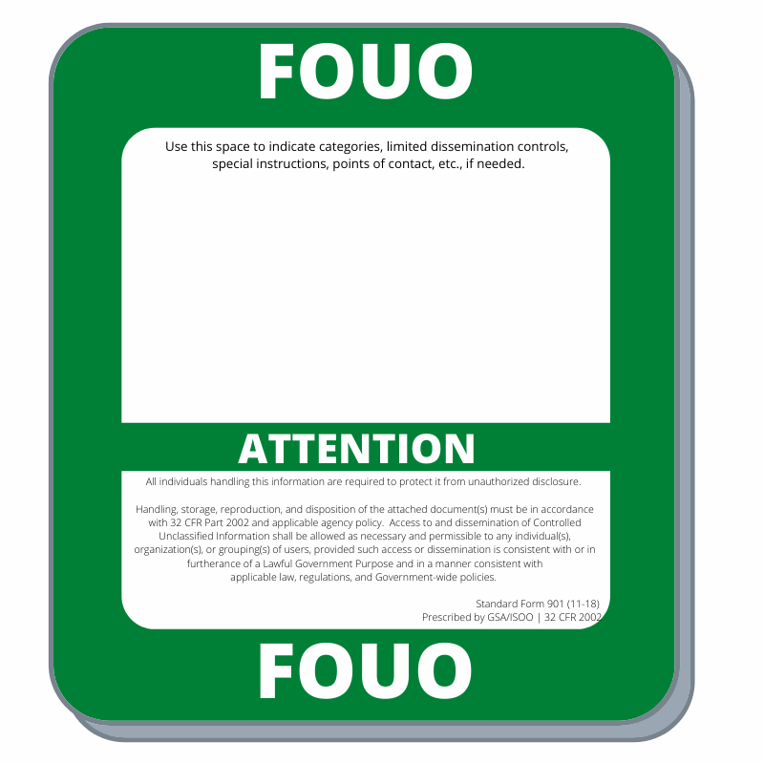
PREVIOUS/
LEGACY MARKINGS
FOUO as a marking identification should no longer to be utilized.
  Engage with Information Owners that are still using FOUO and reach out to DCSA to assist if needed.
Legacy information (such as FOUO, SBU) does not automatically become CUI. It must be reviewed by the Information Owner to determine if it meets the CUI requirements.
  Legacy marked information stored on a DoD access-controlled website or database does not need to be re-marked as CUI.
  When legacy information is incorporated into, or cited in, another document or material, it must be reviewed for CUI and marked accordingly.
It is our responsibility to protect legacy information until such time that the Information Owner reviews the information to determine if the data meets the CUI requirements and re-marks this data accordingly.
Legacy Distribution Statements
Legacy CUI technical documents and materials have used distribution statements in order to address the shared responsibility between the DoD and its contractor to safeguard this information. This was done for legacy CUI creation, transmission, receipt, storage, distribution, decontrol, and approved disposition authorities, including destruction.

Slide 7
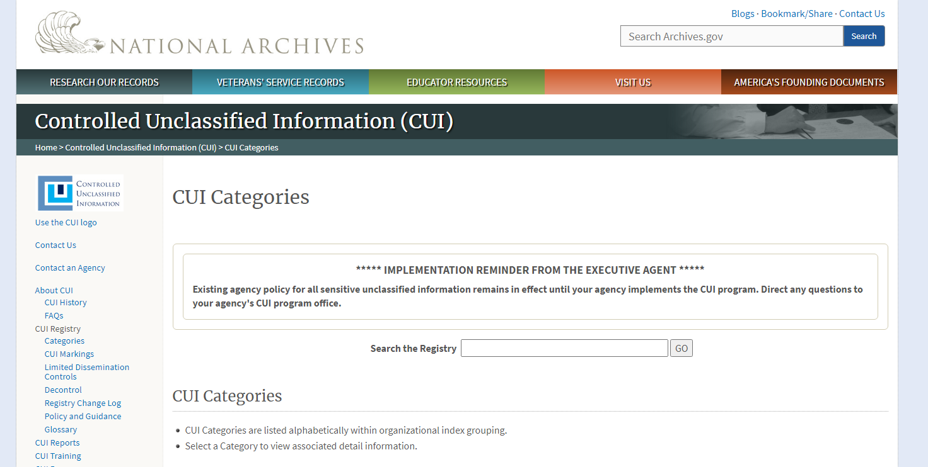
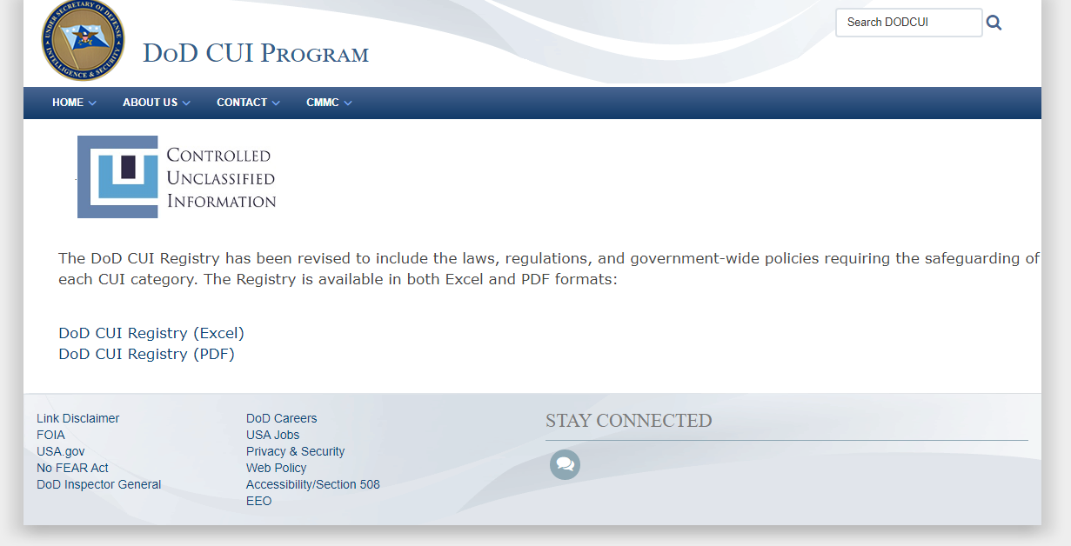
HOW DO THEY DECIDE?
CATEGORIES OF CUI
For information to be considered CUI,
it must fall within a category, such as:
Critical Infrastructure
Defense
Export Control
Financial and Tax
Immigration
Intelligence
International Agreements
Law Enforcement
Legal
Natural and Cultural Resources
NATO
Nuclear
Patent
Privacy
Procurement and Acquisition
Proprietary Business Information
Provisional (for DHS use only)
Statistical
Transportation
There is a registry for that!
There are TWO registries. The owner of the information determines which registry to use. The Information Owner of the CUI must consult the appropriate registry to find the indexes and categories used to identify the various types of CUI.
1
2
ISOO Registry The National CUI Registry contains Indexes and categories for the entire Executive Branch and should be consulted for non-DOD contracts.
DoD Registry The DOD CUI Registry aligns each Index and Category to DOD issuances.
https://www.archives.gov/cui/registry/category-list
https://www.dodcui.mil/Home/DoD-CUI-Registry

Slide 8

WHO DECIDES?
The Information Owner of a document or materials is responsible for determining, at the time of creation, whether the information in a document or materials falls into a CUI category. If so, the Information Owner is responsible for applying the appropriate CUI markings and dissemination controls accordingly.
Information Owners include:
DoD civilian and military personnel
Agencies
Contractors providing support to the DoD pursuant to contractual requirements

Slide 9
CUI LIFECYCLE
CUI is information created or generated in support of a Government contract.
Whenever CUI is distributed, the Information Owner shall ensure who they are distributing to has the proper controls for receiving and protecting CUI.
However, it is everyone’s responsibility to identify if they receive CUI and handle accordingly.

Slide 10
CUI is created when put on paper or entered into an information system.

Slide 11
What is CUI?
CREATING CUI
CUI is generally government-created or owned information that requires safeguarding or dissemination controls consistent with applicable laws, regulations and government-wide policies.
Anyone can be an Information Owner and create CUI as long as it is generated for, or on behalf of, an Executive Branch agency under a contract and it falls into one of the over one hundred DOD CUI categories. However, in most situations, Industry will be guided by its customer (the Information Owner) on what is CUI and what isn’t.
CUI is not a classification and should not be referred to as “classified as CUI.” A better way to phrase it is “designated or categorized as CUI.”
CUI is not corporate intellectual property unless created for or included in requirements related to a Government contract. Contractors should consult with their Government Contracting Activity (GCA) to make this determination.
Access to CUI is based on having a lawful government purpose which is similar to the need-to-know concept for access to classified or FOUO type information but intentionally less stringent.
Material should not be marked CUI in order to:
  Conceal violations of the law, inefficiency, or administrative errors.
  Prevent embarrassment to a person, organization, or agency.
  Prevent open competition.
WHAT IS NOT CUI?
Classified information or a classification
Corporate intellectual property (unless created for or included in requirements related to a government contract)
Publicly available information

Slide 12

CUI Category Types
CREATING CUI
Once the category of CUI is determined then it will then fall under one of these two:
CUI Basic is any category of CUI which a law, regulation, or Government-wide policy says must be protected, but doesn’t provide any further information about how to protect it.
CUI Specified has different marking and handling requirements. It is designed to accommodate the specific requirements of certain customers. CUI Specified is NOT a “higher level” of CUI, it is simply different and cannot be ignored or overlooked because of laws, Federal regulations and government-wide policies.

Slide 13

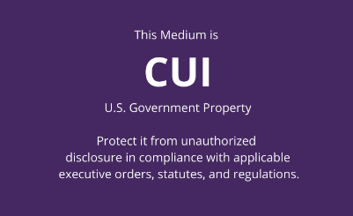
Receiving CUI
CREATING CUI
The Defense Industrial Base (DIB) should understand what types of sensitive information they have. A contractor should ensure safeguards for sensitive information also flow down to subcontractors.
  FAR 52.204-21 defines 15 specific safeguarding controls to protect FCI.
  The Defense FAR Supplement (DFARS) 252.204-7012 lists the safeguarding controls to protect CUI. The family of controls come from the National Institute of Standards and Technology (NIST) Special Publication (SP) 800-171.
Current
  September 2020, Interim DFARS rule 2019-D041 imposed new requirements.
  Contractors working with CUI must now conduct an internal self-assessment based on NIST 800-171 to meet specified Cybersecurity Maturity Model Certification (CMMC) level.
  Contractors must upload their assessment scores into the Supplier Performance Risk System (SPRS). Before making an award, contracting officers now must verify that the SPRS score is not more than 3 years old.
  The development of a System Security Plan (SSP) may assist with the implementation and identification of CUI protection requirements for all covered systems. For each control that is not met, the contractor may consider the use of a Plan of Action and Milestones (POAM) to track implementation of each control not implemented. Here is a CUI plan of action template and a CUI SSP template.
  More information about CMMC can be found at: https://www.acq.osd.mil/cmmc/faq.html

Slide 14
The Information Owner of the CUI material is responsible for marking the material before distributing so that anyone receiving the CUI can properly identify it.

Slide 15
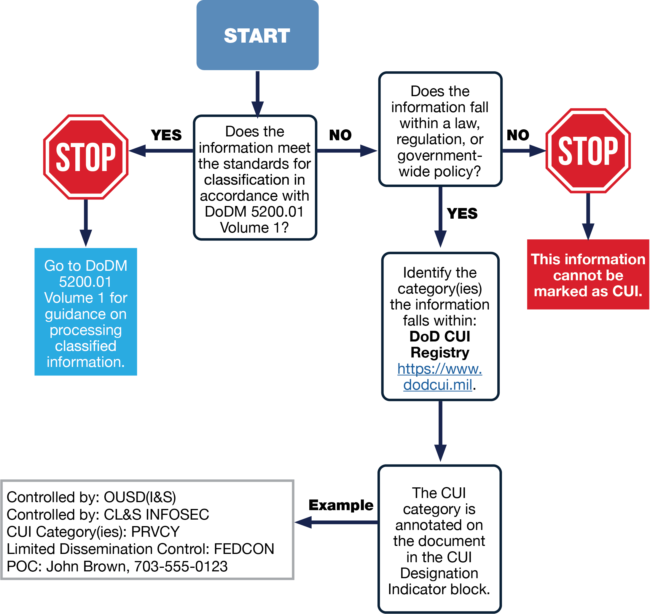
Identification
IDENTIFY & DESIGNATE
The identification of CUI is critical in determining what sensitive information needs to be protected.
CUI is generated by or on behalf of an agency within the Executive Branch and falls into one of the more than one hundred categories of CUI in the National CUI Registry.
WHAT IS NOT CUI?
Classified information or a classification
Corporate intellectual property (unless created for or included in requirements related to a government contract)
Publicly available information

Slide 16
Federal Contract Information
IDENTIFY & DESIGNATE
FCI Information
is not marked as public or for public release.
Minimum cybersecurity requirements in a non-federal information system:
Basic Safeguarding Clause 48 CFR 52.204-21.
Federal Contract Information (FCI) (48 CFR 52.204-21) is not intended for public release and is provided by or generated for the Government under a contract to develop or deliver a product or service to the Government, but not including information provided by the Government to the public (such as on public websites) or simple transactional information, such as necessary to process payments.
Click this link for more on FCI.
Public Information
or information marked for public release.
Minimum security requirements in a non-federal information system: None
CUI Information
that is marked or identified as requiring protection under the CUI program.
Minimum security requirements in a non-federal information system: NIST SP 800-171.

Slide 17
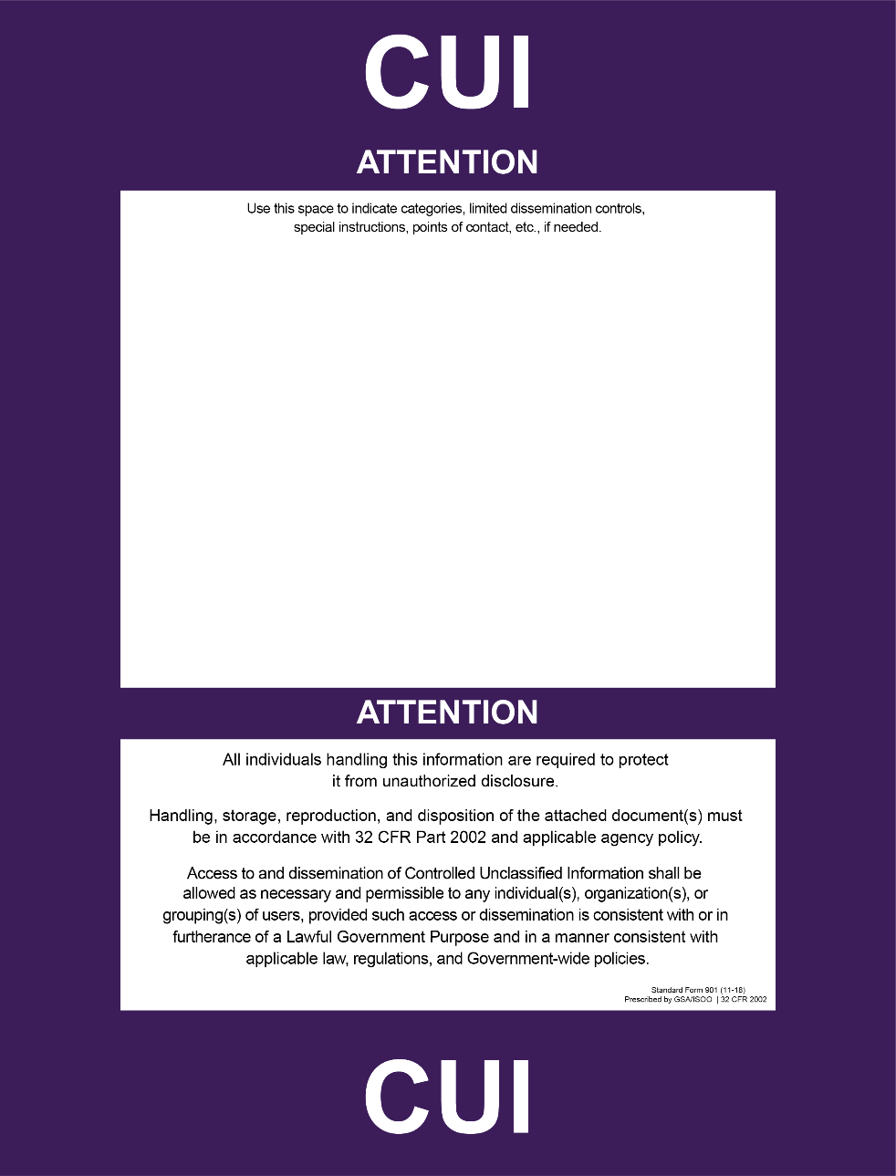
All physical and digital media must be marked or labeled to alert individuals to the presence of CUI.
At minimum, CUI markings for unclassified DOD documents will include the acronym “CUI” or “CONTROLLED” in the banner of the document.

Slide 18
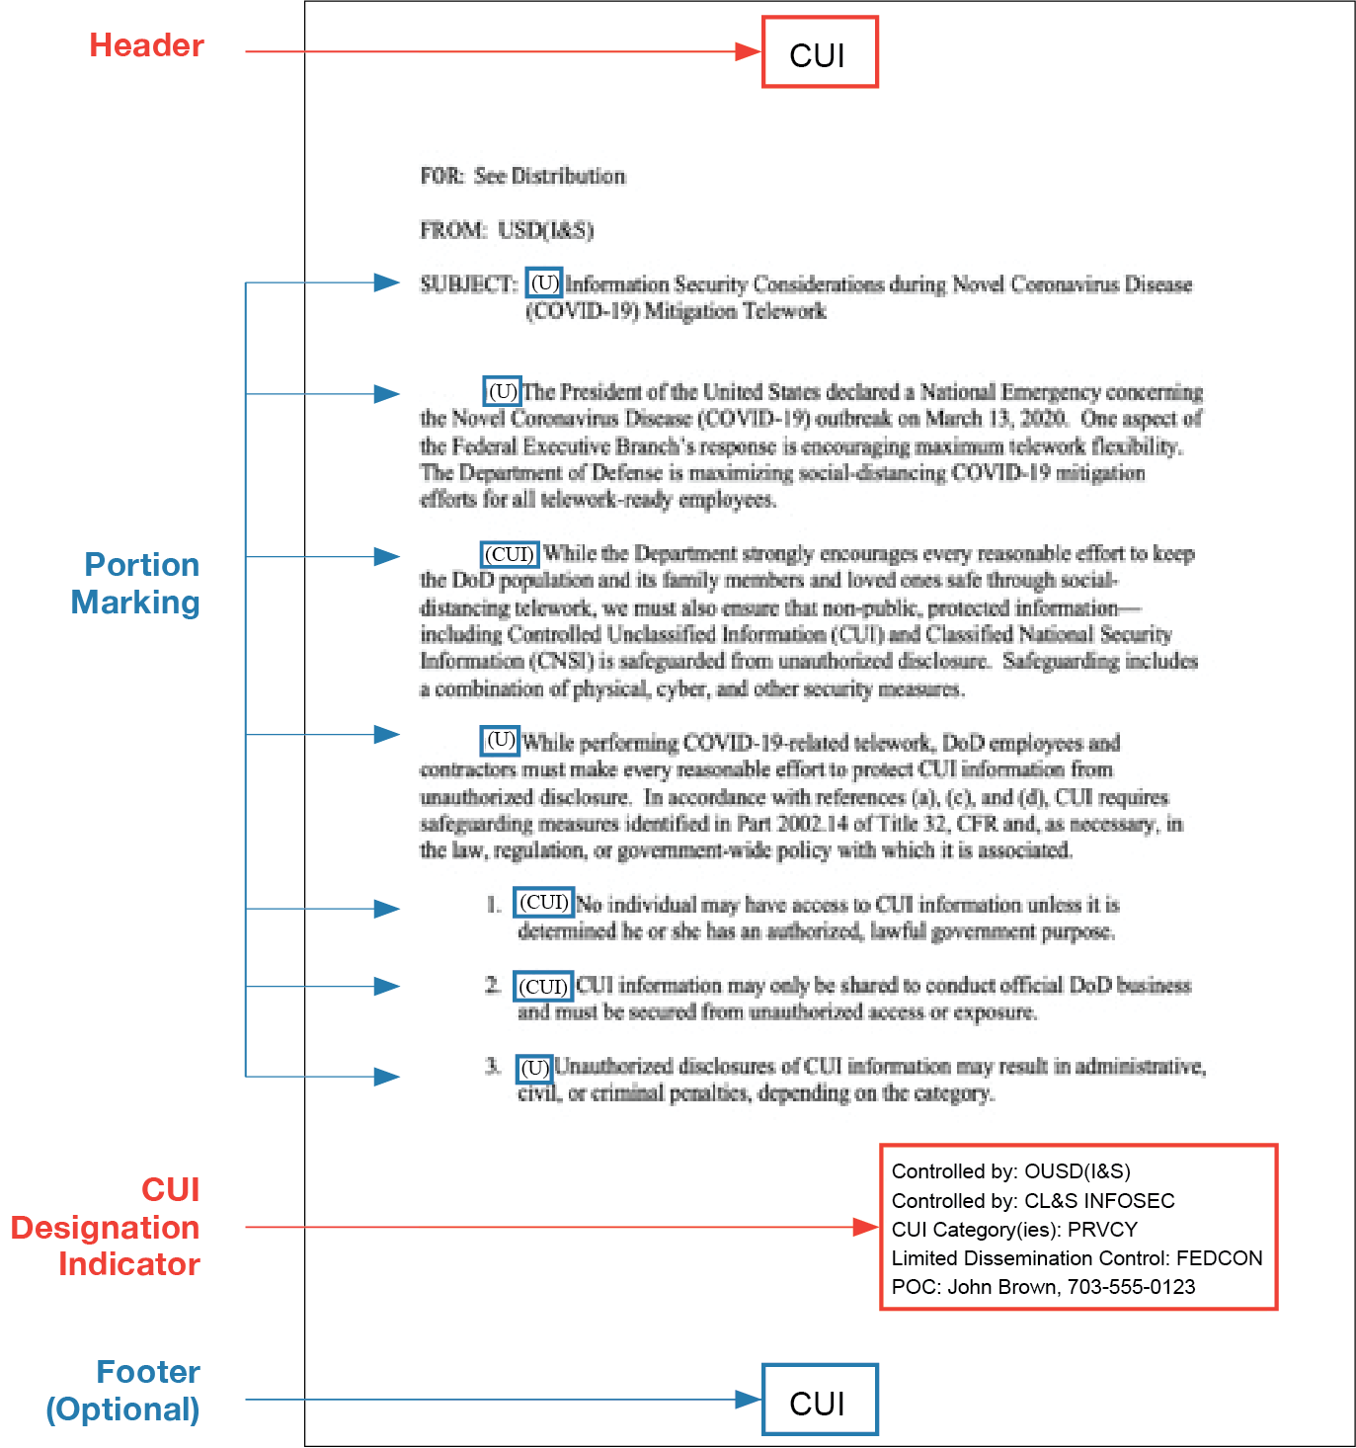
Marking Documents
MARK/LABEL
Required
  Header/top/banner of document has “CUI” or “CONTROLLED” in bold letters
  Designation Indicator (5 items)
Not required/optional
  Portion marking (If you use portion marking, you must portion mark everything. Subjects, titles, individual sections, parts, paragraphs, or similar portions known to contain CUI, will be portion marked with “(CUI)” and everything else will have a “(U)” in front of the sentence).
  CUI coversheet
  Bottom/footer marking (but highly recommended!)
  Page numbers
Other Notes
  There is no requirement to add the “U”, signifying unclassified, to the banner and footer as was required with the old FOUO marking (i.e., U//FOUO).
  Do NOT use “UNCLASSIFIED “U” before “CUI” in banner line or portion markings.
  Supplemental markings commonly used to inform recipients of the non-final status of a document (e.g., DRAFT, Pre-decisional, Working Paper) do not go in the banner line as they are not authorized CUI categories used to control information. Supplemental markings can be placed outside the banner line if approved by the Information Owner.

Slide 19
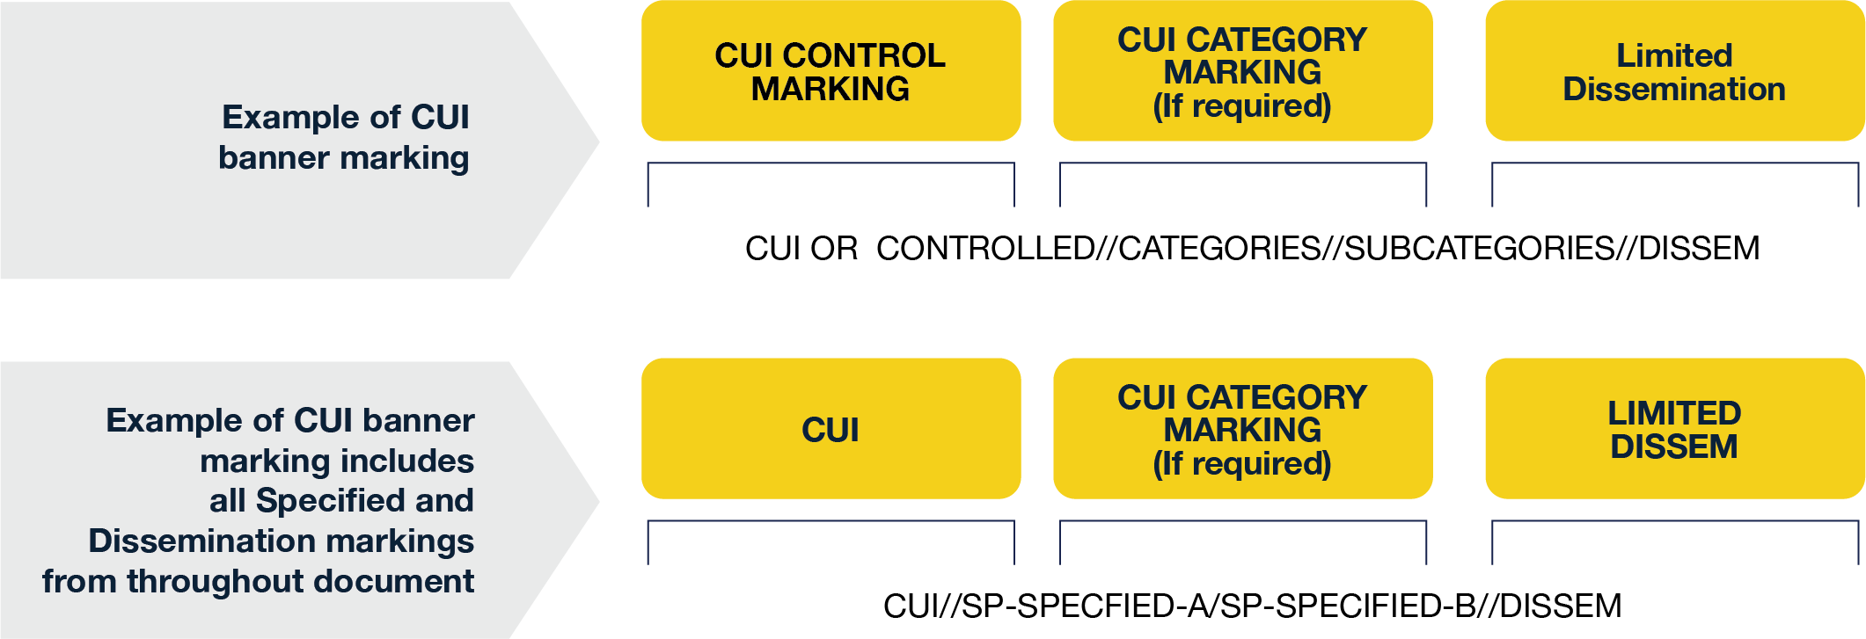
CUI Banner Marking
MARK/LABEL
These are preceded by a double forward slash (//) to separate them from the rest of the CUI banner marking. When a document contains multiple Limited Dissemination control markings, those Limited Dissemination control markings must be alphabetized and separated from each other with a single forward slash (/).

Slide 20

Designation Indicator
MARK/LABEL
The designation
indicator MUST INCLUDE
these five items.
Name (Who owns this?)
Insert the name of the DoD component (GCA/IO)
if not otherwise identified in the letterhead.
This is typically the Information Owner.
Controlled By (Who controls this?)
Insert the name (GCA/IO) of the office creating the
document and making the CUI determination CUI.
Category (CTI? OPSEC? PRVCY?)
Identify all types of CUI contained in the document.
Distribution/Limited Dissemination Control (What other restrictions?)
Insert applicable Distribution Statement or LDC.
(See more Distribution Statements on the next slide)
POC (Who is the main contact?)
Include name and phone number or office mailbox for the originating DoD component or authorized CUI holder.
If you receive CUI and you don’t see these five items on the first page (or coversheet), you should request them from the Information Owner or customer.
Review the definitions to understand the difference between #1 (Name) and #2 (Controlled By). Name
will be the customer but Controlled By may be a different customer or division. For example, your facility has a contract with GCA. The Name would be the GCA but Controlled By is the Information Owner and
may be different from
the customer.
Name: OUSD(I&S)
Controlled by: CL&S INFOSEC
CUI Category(ies): PRVCY
Limited Dissemination Control: FEDCON
POC: John Brown, 703-555-0123

Slide 21
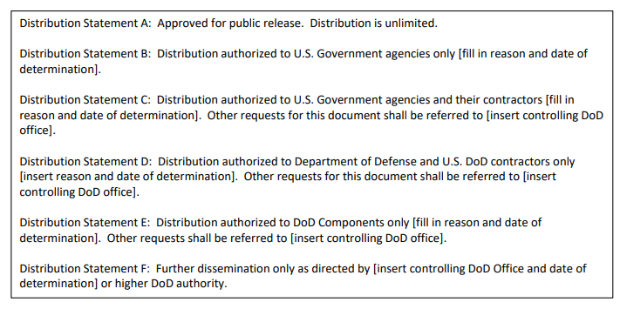
Distribution Statements
(Part of Designation Indicator)
MARK/LABEL
Distribution statements, in accordance with DoDI 5230.24, are authorized for use with:
CUI export controlled technical information
Other scientific, technical, and engineering information
Controlled technical information

Slide 22
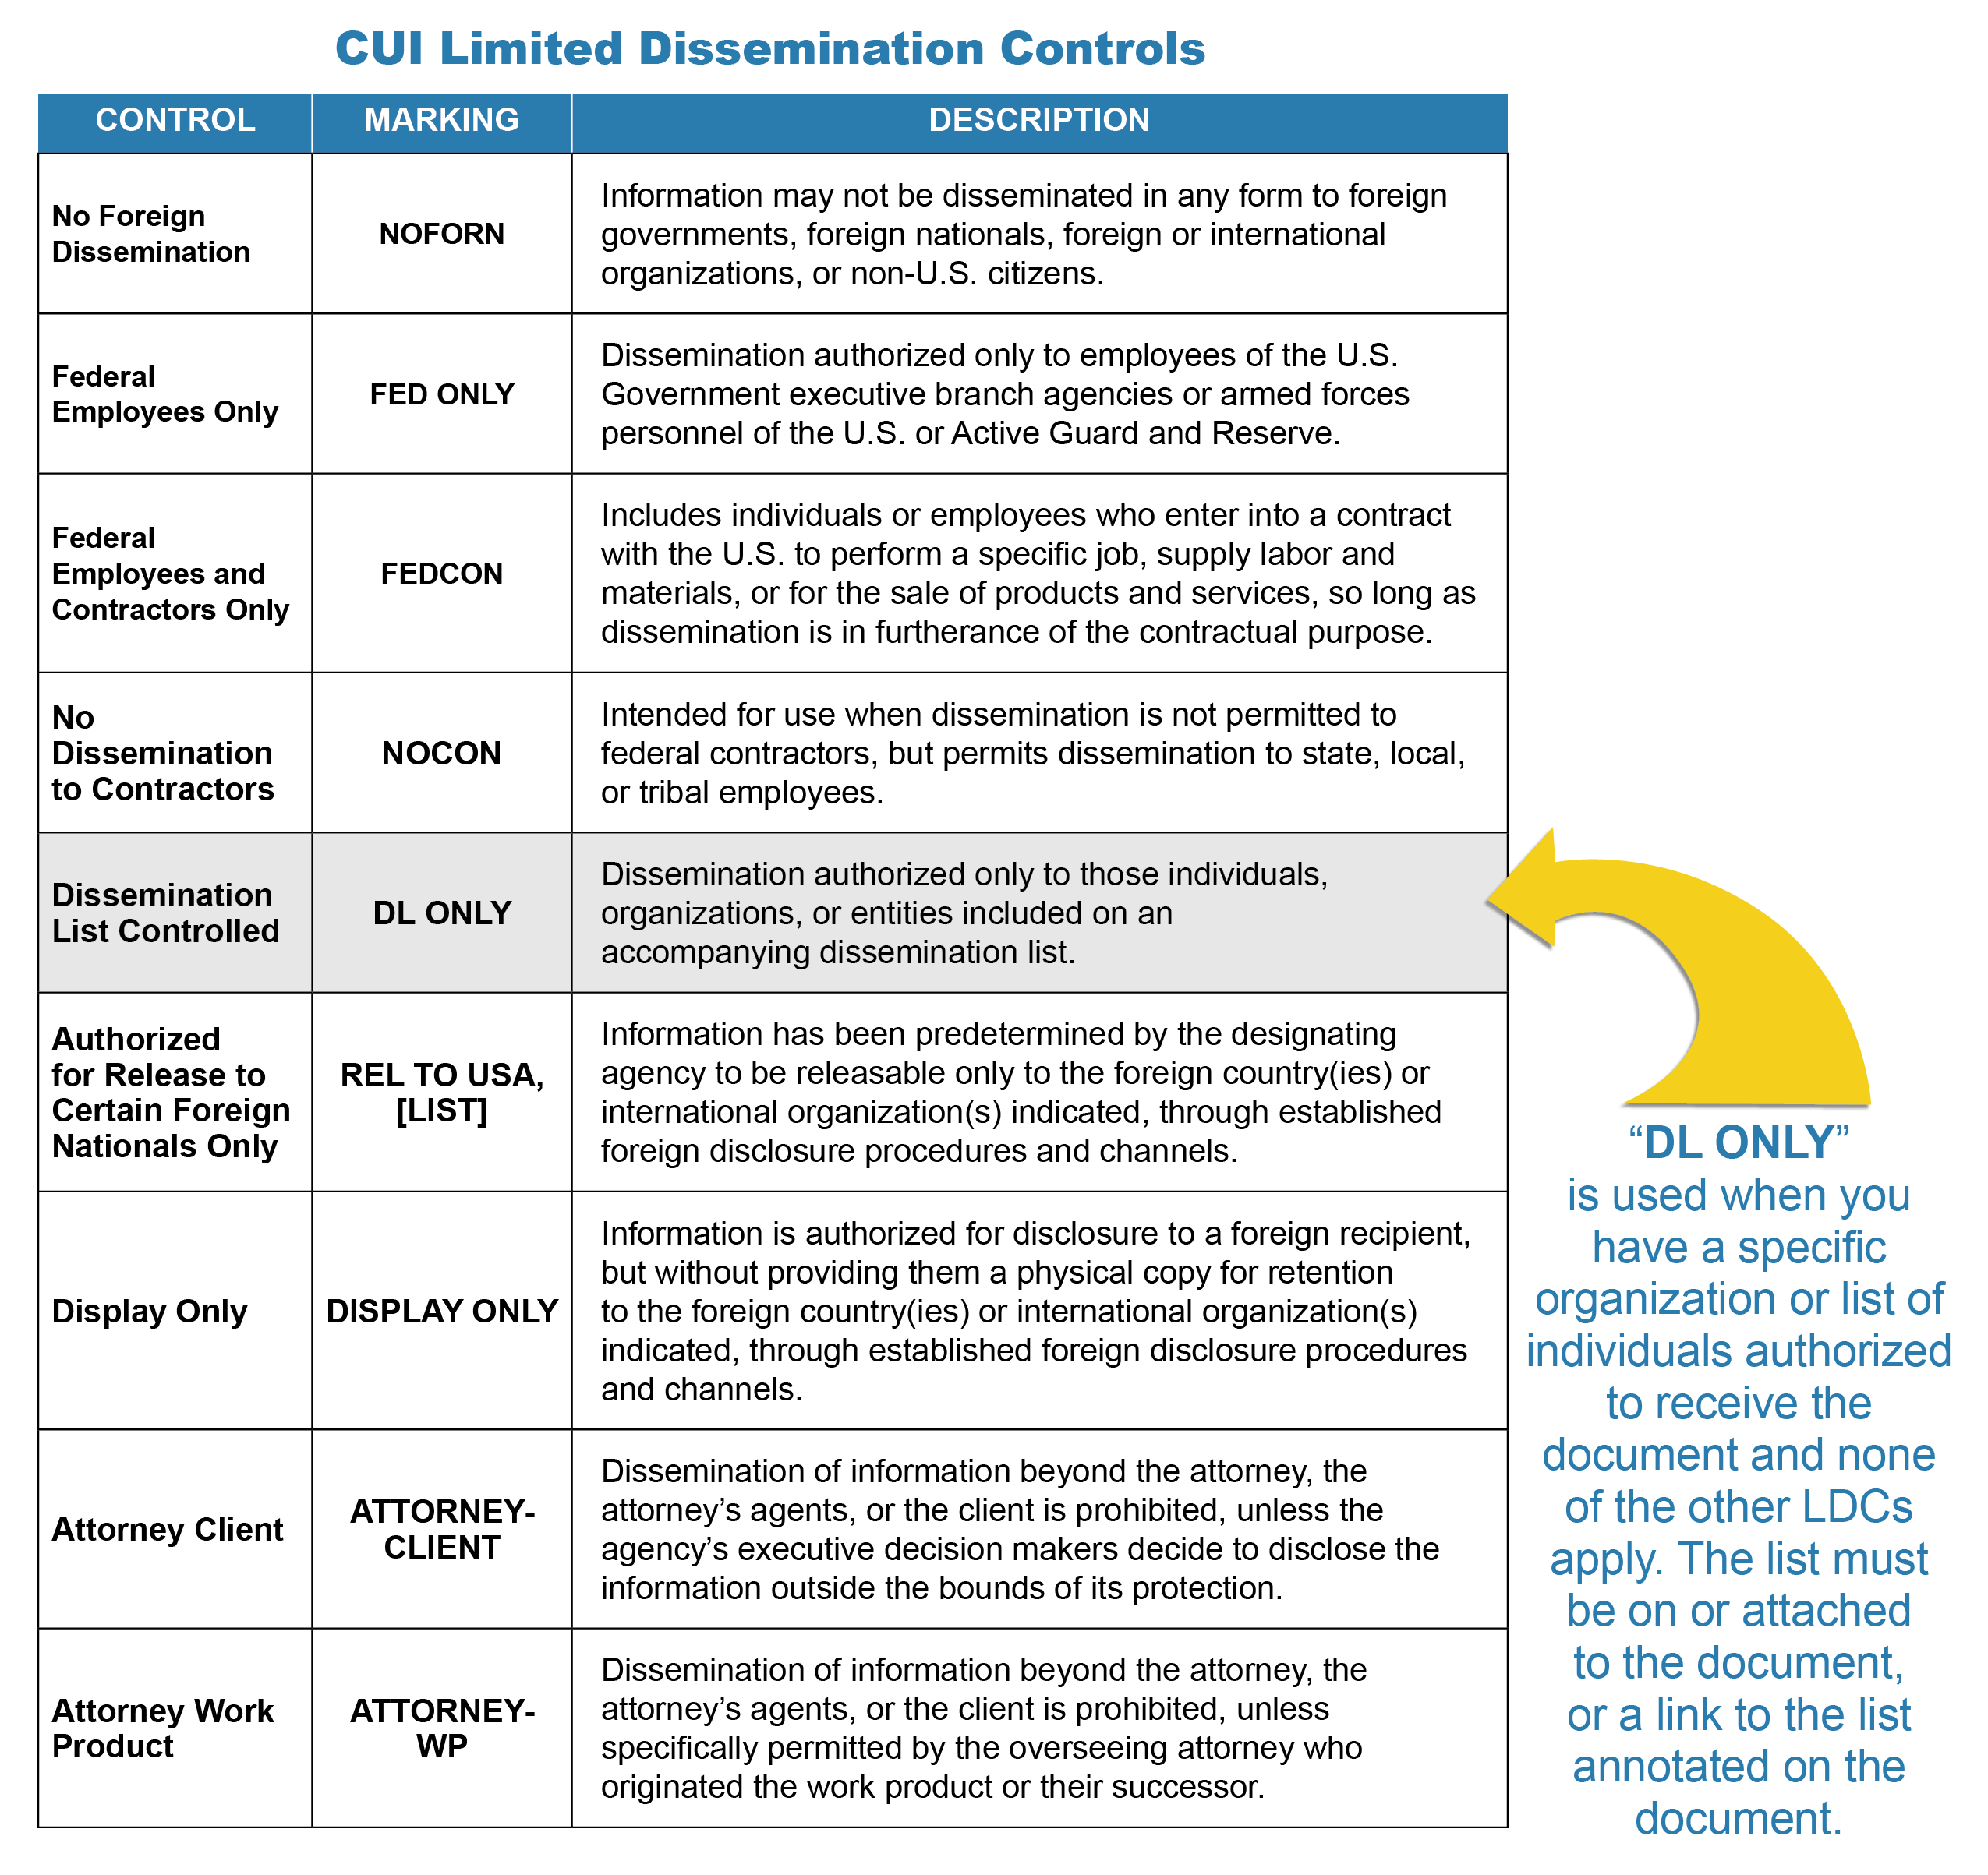
Limited Dissemination Control Markings
(Part of Designation Indicator)
MARK/LABEL
32 CFR Part 2002.4 defines LDC as any CUI EA-approved control that agencies may use to limit or specify CUI dissemination.
LDCs are to be placed on unclassified documents and other materials when the CUI requires access restrictions, including those required by law, regulation, or government-wide policy.
LDC markings cannot unnecessarily restrict CUI access, e.g., do not mark a document as “No Dissemination to Contractors” or “NOCON” unless there is a law, regulation, or policy that prohibits dissemination to a contractor.
LDCs identify the audience deemed to have an authorized lawful government purpose to use the CUI.
The absence of an LDC on a document means anyone with an authorized lawful government purpose is permitted access to the document. This does not imply it can be publicly released. All CUI documents must go through a public release review in accordance with DoDI 5230.09 and 5230.29.
For a complete list LDC markings visit www.dodcui.mil.
LDC markings are NEW TO CUI and was not required
on FOUO or other legacy materials.

Slide 23
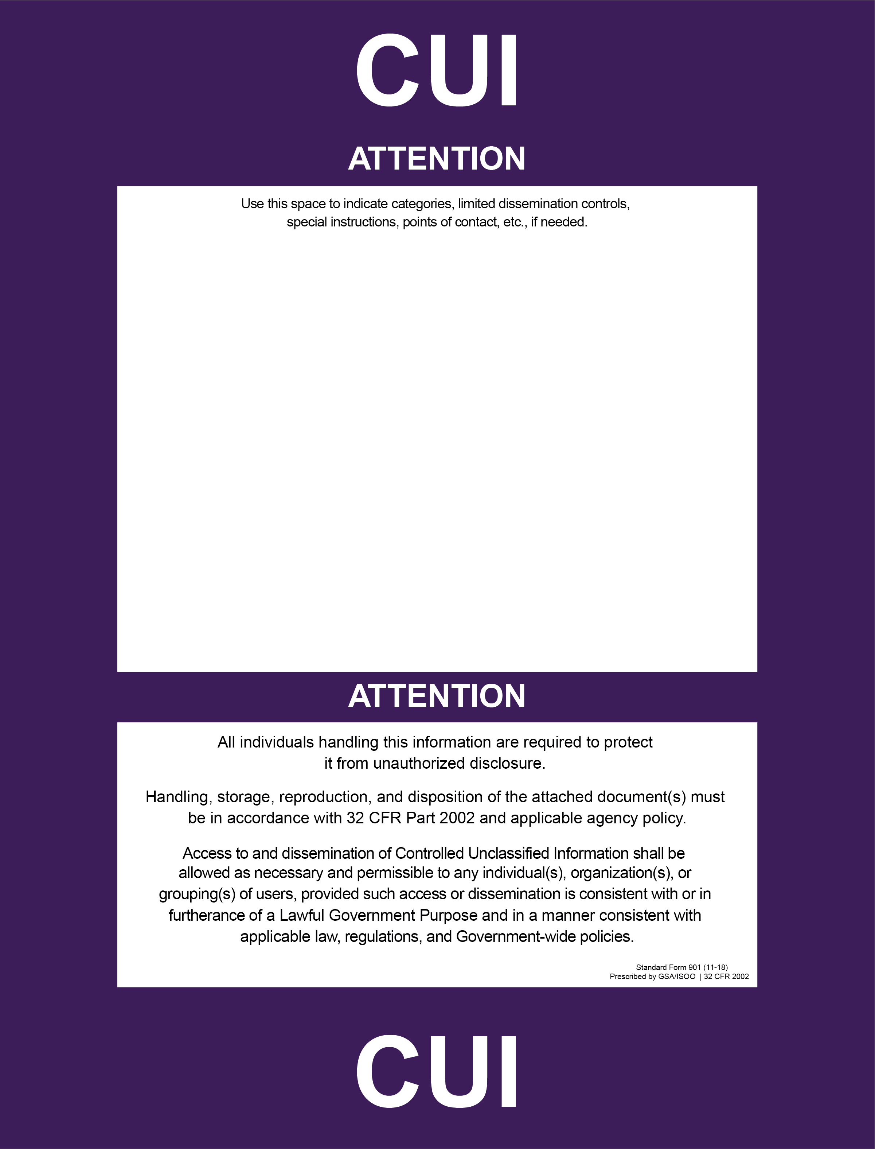
CUI Coversheets (Optional)
MARK/LABEL
First blank area of coversheet CAN be filled out with Designator indicator.
You can download a copy of the CUI coversheet (SF901) at either of these sites:
  https://www.gsa.gov/forms-library/controlled-unclassified-information-cui-coversheet-0
  https://www.archives.gov/cui/additional-tools
Name: OUSD(I&S)
Controlled by: CL&S INFOSEC
CUI Category(ies): PRVCY
Limited Dissemination Control: FEDCON
POC: John Brown, 703-555-0123

Slide 24

Marking CUI and Classified
MARK/LABEL
“CUI” markings do not go in banner.
Classified documents will be marked IAW DoDM 5200.01 Volume 2.
Portion markings are required.
CUI markings will appear in portions known to contain only CUI.
Document will have both the CUI Designation Indicator and Classification Authority.

Slide 25
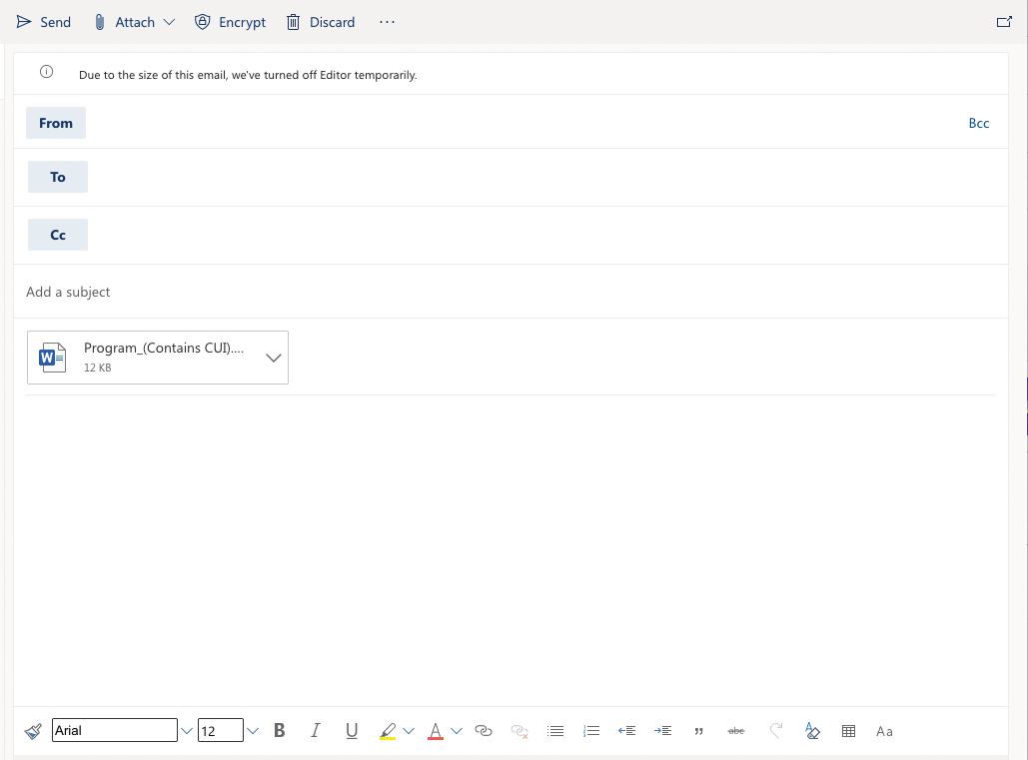
Emails with CUI
MARK/LABEL
2.
Required
  Must apply “CUI” to top/banner.
  Must be encrypted.
  Must contain a CUI Designation Indicator block.
  If including attachments containing CUI, the file name must indicate it includes CUI.
Optional but best practice
  Apply “CUI” to the footer and subject line.
  All paragraphs known to contain CUI may be portion marked.
JohnDoe2@agency.gov
JaneMajor@agency.gov
5.
Program Technical Documentation (Contains CUI)
4.
1.
CUI//PRVCY/FEDCON
(CUI) Unclassified emails are like documents and must be marked the same way. Emails must include banner line (which is the same thing as header in document), portion markings, CUI designation indicator and footer.
(U) Portion markings are Optional
Name: OUSD(I&S)
Controlled by: CL&S INFOSEC
CUI Category(ies): PRVCY
Limited Dissemination Control: FEDCON
POC: John Brown, 703-555-0123
CUI//PRVCY/FEDCON
6.
3.
DO NOT USE PERSONAL EMAIL ACCOUNTS to send CUI. This is necessary to ensure proper accountability for Federal records and to facilitate data spill remediation in accordance with Public Law 113-187 and the January 16, 2018 Deputy Secretary of Defense memorandum.
5.

Slide 26
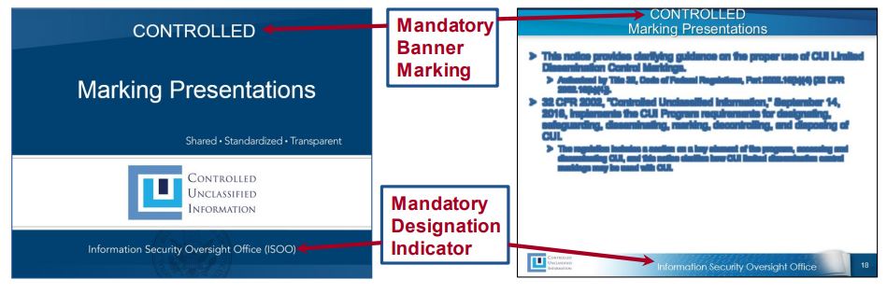
Marking Presentations
MARK/LABEL
Mark all slides top and bottom as you would any other document containing CUI except when the presentation is comingled with classified.
Front cover must have the CUI Designation Indicator block.
Classified briefings that contain CUI must have both the classification block, and CUI Designation Indicator block.
Any warning boxes or distribution statements required by a Law, Regulation, or Government-wide policy (LRGWP).
Alternate acceptable placement of “CUI” in top and bottom corners.

Slide 27



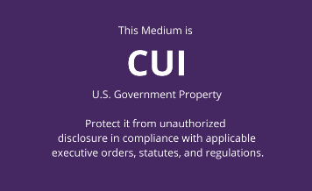
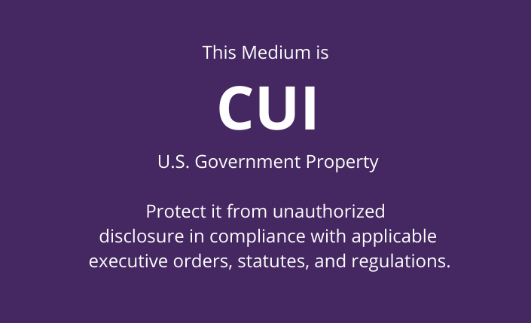
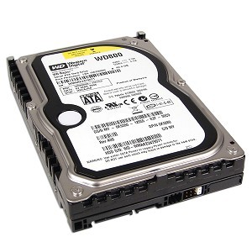
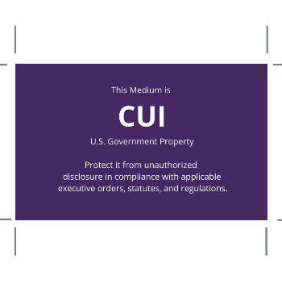
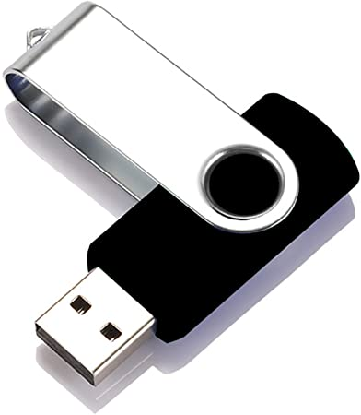
Marking Media
MARK/LABEL
This system contains CUI
Removable media and storage devices containing CUI must be marked.
Standard Form 902 (stickers) are available through GSA for purchase but only the Government can order them. Find out more here.
You can also create your own stickers. Find out more here.
It is recommended you always engage with your Information Owner for additional guidance on what is required to be marked to safeguard CUI (systems, materials etc.).
References:
  ISOO marking guidebook for more information https://www.archives.gov/files/cui/20161206-cui-marking-handbook-v1-1.pdf
  32 CFR 2002 https://www.federalregister.gov/documents/2016/09/14/2016-21665/controlled-unclassified-information

Slide 28
Other Marking Considerations
MARK/LABEL
Once you start marking a document, the entire document must be marked with the banner markings.
CUI Category Marking is mandatory for CUI Specified.
The below warning statement will be placed at the bottom of the first page of multi-page documents alerting readers to the presence of CUI in a classified DoD document.
DO NOT
Insert CUI in the banner line for classified documents.
Spell out CUI categories.
“This content is classified at the [insert highest classification level of the source data] and may contain elements of controlled unclassified information (CUI), unclassified or information classified at a lower level than the overall classification displayed. This content shall not be used as a source of derivative classification; refer instead to the [cite specific reference, where possible, or state the applicable classification guide(s)]. It must be reviewed for both Classified National Security Information (CNSI) and CUI in accordance with DoD 5230.09 prior to public release.” [Add a point of contact when needed.]

Slide 29
CUI can be stored in NIST 800-171 compliant information systems or controlled physical environments.

Slide 30
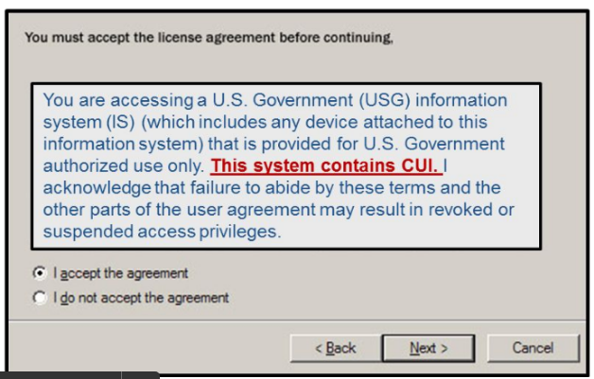
System Storage
STORE
Per the DoDI 8500.01:
“Systems processing CUI will be categorized at no less than the moderate confidentiality impact level in accordance with Part 2002
of Title 32, Code of Federal Regulations (Reference (z)).”
Always engage with your Information Owner for additional requirements.
It is recommended at the minimum to include a “splash screen” users must agree to before logging into system or using stickers/banners.
The NIST SP 800-171 governs and protects CUI on
non-Federal Information Systems.
Here is a CUI POAM template and a CUI SSP template.
This system contains CUI

Slide 31
Physical Storage
STORE
During Working Hours
  Personnel must take care not to expose CUI to unauthorized users or others who do not have a lawful government purpose to see the information.
  CUI cover sheets (not required) may be placed on top of documents to conceal the contents from casual viewing.
  Always control or protect CUI with at least one physical barrier and take reasonable care to ensure that the information is protected from unauthorized access and observation.
After Working Hours
  Store in unlocked containers, desks, or cabinets only if facility provides continuous monitoring. If not, CUI must be in a locked desk, file cabinet, locked room or where security measures are in place to prevent or detect unauthorized access.
  Locked container should indicate it contains CUI.
  Do Not store CUI in public areas (car, home office etc.) or view while on public transportation.

Slide 32
CUI is limited to those with a lawful Government purpose.
  A lawful Government purpose is any activity, mission, function, operation, or endeavor that the U.S. Government authorizes or recognizes as within the scope of its legal authorities or the legal authorities of non-executive branch entities (such as state and local law enforcement).

Slide 33
Sharing CUI
DISSEMINATE
IN PERSON
Ensure you are in a controlled area where you cannot be overheard, recorded etc.
ELECTRONIC TRANSMISSION
  Must apply “CUI” to top/banner.
  Must be encrypted.
  Must contain a CUI Designation Indicator block.
  If including attachments containing CUI, file name must indicate it includes CUI.
  DO NOT USE PERSONAL EMAIL to transmit CUI.
  There are available Secure File Transfer Protocol (SFTP) sites (i.e. SAFE site).
  Always check with your customer on which sites you are able to use.
FAX
  Sender is responsible for determining appropriate protections are in place at the
  receiver end and Fax machine is located in a controlled government facility.
  Sender should contact receiver to inform them CUI is being transmitted.
MAIL
  May be transmitted via first class mail, parcel post, or bulk shipments.
  Do not place CUI markings on the outer envelopes or packaging when mailing.
  Address packages that contain CUI for delivery only to a specific recipient.
  DO NOT put CUI markings on the outside of an envelope or package for mailing/shipping.
  Remember to track the package.
When to share CUI?
When access promotes a common project or operation between agencies or under a contract or agreement with the designating agency, then share!
When NOT to share CUI?
If access harms or inhibits a common project or operation between agencies or under a contract or agreement with the designating agency, then do not share.

Slide 34
CUI should be destroyed or decontrolled whenever possible to reduce risk of exposure to unauthorized individuals.
Employees and contractors should contact the Information Owner to discuss decontrolling (downgrading) the CUI material when the need arises.
Triggers to request decontrol may include:
Request to release the CUI material to the public
End of contract
Contract Renewal

Slide 35
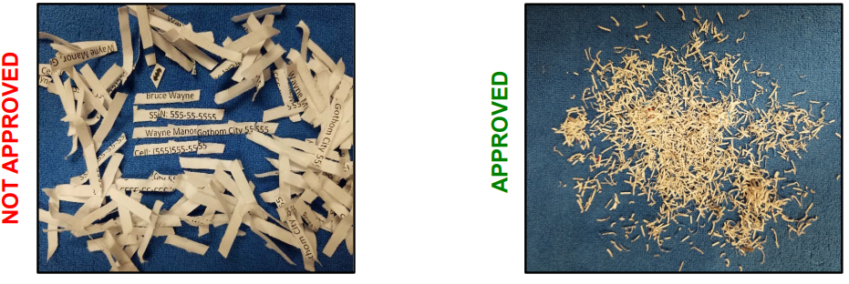
Shredding
DESTROY
When you are finished with paper CUI, per the ISOO Notice, CUI must be destroyed using a cross-cut shredder that produces particles less than 1mm by 5mm. For companies that have classified, shred machines used to shred classified meet this requirement.
If you are utilizing a third-party shred company (i.e., ShredIT®), as long as you can prove the company is recycling the material to make it unreadable after it shreds (no matter the size of the shred), this also meets the requirement.

Slide 36
The only entity that is authorized to decontrol CUI is the Information Owner.
Decontrolling occurs when the Information Owner of the CUI material removes safeguarding or dissemination controls from CUI that no longer requires such controls.
CUI documents and materials must be formally reviewed in accordance with DoDI 5230.09 before being decontrolled or released to the public.

Slide 37

UNAUTHORIZED DISCLOSURE (UD)/ FAILURE TO PROTECT
The 32 CFR 2002 states “Unauthorized disclosure occurs when an authorized holder of CUI intentionally or unintentionally discloses CUI without a lawful Government purpose, in violation of restrictions imposed by safeguarding or dissemination controls, or contrary to limited dissemination controls.”
Failure to properly mark, control, and protect CUI falls under the personnel security adjudicative guideline of “Handling Protected Information.”
The misuse, mishandling, or unauthorized disclosure of CUI is to be reported to the designated official at the worksite and the Security Manager or company Facility Security Officer (FSO).
These rules apply to both cleared and uncleared personnel that access CUI as part of their job performance.
5200.48 – For UD of CUI, no formal security inquiry or investigation is required unless disciplinary action will be taken against the individual(s) responsible. In such cases, a preliminary inquiry is appropriate. UD of certain CUI, such as export controlled-technical data, may also result in potential civil and criminal sanctions against responsible persons based on the procedures codified in the relevant law, regulation, or government-wide policy. The DoD Component originating the CUI will be informed of any UD.”

Slide 38

WRAP UP
National Security is affected by the loss of CUI and we must protect it.
The FIRST thing you should do is work with the Information Owner (customer, prime, agency, GCA, etc.) to validate contractual CUI requirements.
Understandings of the NARA and DoD registries are paramount. Get familiar with them!
Stay in the know! Continue to look for updates to the GCA CUI program.
Failure to comply with CUI requirements may result in administrative or criminal sanctions, fines, and penalties.

Slide 39
REFERENCES
  Registries and Source Documents
  NARA CUI Registry https://www.archives.gov/cui
  DoD CUI Registry https://www.dodcui.mil
  Executive Order 13556 – Controlled Unclassified Information
  DoDI 5200.48 (Controlled Unclassified Information)
  DFARS 252.204-7012 clause
  Coversheets, stickers and more!
  32 CFR 2002 CUI Final Rule NARA
IT/Systems
  DODI 8500.01 (Cybersecurity)
  ​NIST 800-171 (CUI on nonfederal systems)
  NIST 800-172 - Enhanced Security Requirements for CUI
CMMC
  OUSD A&S CMMC Site
  CMMC Accreditation Body (CMMC-AB) https://www.cmmcab.org
  CMMC Home Page https://www.acq.osd.mil/cmmc/draft.html
  Training Materials
  https://www.dcsa.mil/mc/ctp/cui/
  https://www.archives.gov/cui/training.html
  https://www.dodcui.mil/Home/Training/
  CUI quick reference guide
  Coversheets
  https://www.gsa.gov/forms-library/controlled-unclassified-information-cui-coversheet-0
  https://www.archives.gov/cui/additional-tools
2010 Nov
2020 Feb
2020 Mar
Executive Order 13556
32 CFR Part 2002
2016 Nov
2019 Dec
DFARS 252.204-7012 clause
SP 800-171
DoDI 5200.48
2016 Sept
ISOO Notice (CUI training)
Timeline

Slide 40
REFERENCES
Comparison of old vs. new CUI
Type of Info
Marking
Distribution
Authority to Withhold
For Official Use Only
Distro A, B, etc.
FOIA Exemptions 2-9
CUI
Previous CUI Policy
DoDM 5200.01 V4
(FOUO)
DoDI 5230.24
Type of Info
Marking
Dissemination
Requirement to Protect
DoD CUI Category
CUI
Distribution statements
Law, Regulation. or Government wide policy
New CUI Policy
DoDI 5200.48
(CUI)
CUI Registry
(ISOO Portal)
Limited Dissemination Controls (LDC)
CUI//REL TO

Slide 41

CERTIFICATE OF COMPLETION
If you have any questions, concerns, or require assistance, please contact:
[ENTER ORGANIZATION/COMPANY NAME]Security Manager/Facility Security Officer.
We are here to help you and ensure that [ENTER ORGANIZATIONCOMPANY NAME] remains compliant with CUI requirements.
________________________________________________________________________
Organization/Company Name: [ENTER NAME]
Security Manager/FSO Name: [ENTER NAME]
Security Manager/FSO Email Address: [ENTER EMAIL]
Security Manager/FSO Phone Number: [ENTER PHONE]
Your name: ____________________________
Signature: _____________________________
Date: _________________________________

